Slide 1
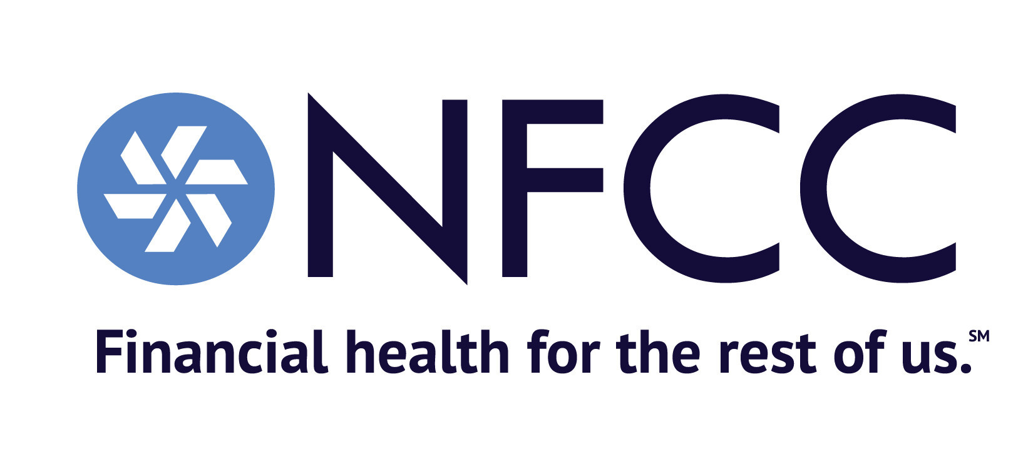
Independent Workers Discovery & Opportunities
Team Extra Credit
Working with
Nour AlGharibeh, Jessica Franko, Zhuqing Cui, Kyle Chappel, Prisillah Thomas, Sara Bai

Slide 2



Initial Problem Focus
Within the constraints for credit counseling, NFCC is looking to redefine the small business owners (SBO) program to realize three goals:
Helping SBOs & gig workers who struggle with debt
Connecting to the SBOs & gig workers to provide these services more effectively
Focus on minority independent workers, specifically Black + LatinX
Notes:
Kyle
Make it concise!
Thank you for joining us this morning. We’re Extra Credit. We want to start by both introducing you to and taming some of the complexity of the problem space. We began our work exploring how we might improve credit counseling and education for both gig economy workers and small business owners struggling with debt. We wanted to explore how we might connect with them more effectively and we also wanted to understand how minority gig workers and business owners are impacted, especially in light of the pandemic. From here we went broad to have a holistic understanding of the space.

Slide 3
The American workforce by the numbers
Approximately 150 million people in North America and Western Europe now work as independent contractors, most of them in knowledge-intensive industries and creative occupations. _ Harvard Business Review
1/3
Nearly one-third of the US workforce are freelancers, a growing majority are highly skilled. [1]
According to Upwork, 2 million Americans started freelancing in the 12 months leading up to September 2020 alone.
According to the Intuit 2020 report on the future of gig work, more than 80% of US-based large companies will greatly increase their use of non-traditional workers in the coming years. - Intuit
80%
More than 80% of US-based large companies will greatly increase their use of non-traditional workers in the coming years. [2]
36% of American adults engage in some sort of gig work. And labor trends at enterprise companies suggest that the gig economy has a lot of room to expand: Fully two-thirds of major companies are using freelance contracts to lower their labor costs. - Forbes
Nearly one third of US Workforce are freelancers, a growing majority are highly skilled.
"Millions of well-qualified Americans today are attracted to contract work. Freelancers are now estimated to make up roughly a third of the U.S. workforce, and those who are highly skilled represent a small but growing slice of it. And for the first time since 2014, the number of freelancers who say they consider gig work to be a long-term career choice is the same as the number who consider it a temporary way to make money. Early signs suggest that Covid-19 will also speed up this shift." - HBR
2 M
According to Upwork, 2 million Americans started freelancing in the 12 months leading up to September 2020 alone. [3]
[1] Harvard Business Review [2] Intuit [3] Reuters
Notes:
Kyle
And it’s a space that’s currently undergoing a huge shift. And whether your an SBO, gig worker, or freelancer, it’s affecting the way you work or do your work. In fact, nearly a 1/3 of the US Workforce are freelancers or “on-demand” and a majority are highly skilled. In this case, freelance might include gig workers like delivery drivers to high priced consultants paid by the job. In fact, 80% of US companies are planning to hire non-traditional workers in the coming years. 2 Million started freelancing in the 12 months leading up to September 2020 alone. Many driven into it by the pandemic.

Slide 4
Each gig worker, SBO, and freelancer has their own unique story… And there are millions of stories.
“I’ve worked in hospitality as waitress, bartender, chef...I did everything I needed to know for when the time came for me to own this business I could do it.”
“I was professional cyclist and I own bike shop now. I do a lot of different things.”
“I’ve been bartending for the past 10 years but lost my job during the pandemic. When called to join back, I did not feel like going to the old job. But I had artistic inclinations for a long time, so why not give it a go. I set up my own LLC - on GoDaddy.”
“In August of 2020 my Grandma got dementia… I quit my job to support her and signed up to work with the Census… like gig work.”
“Been in IT for 30 years but the IT industry is all contract work these days because it’s better for the employer. So I started my own business in IT and supplement with other gig works.”
Notes:
Kyle
As we set out to understand Independent Workers, we realized there are millions of stories out there, and all of them are unique. We heard of people getting into it because they lost their job from the pandemic or because they made a choice to support a family member. Some decided to pick up gig jobs, others decided to chase their passions doing their own thing, Often, the decided to do a mix of both.

Slide 5
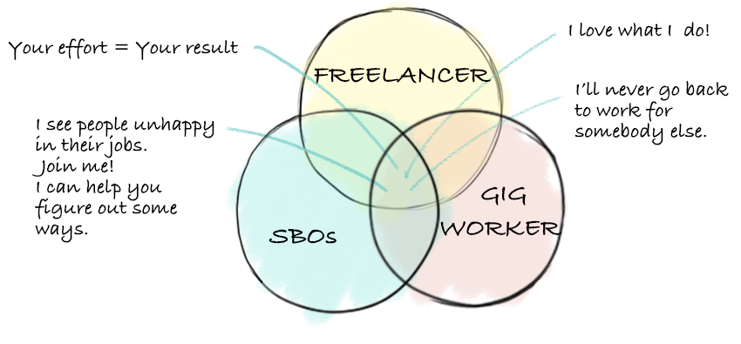
But there are common bonds that unite them.
Notes:
Kyle
In fact, when we looked at it, freelancers were sometimes small business owners. And small business owners were sometimes gig workers. So we decided to focus on the common bonds between them. The motivating factors like owning your results and a desire to connect with people.

Slide 6
Terminology
Independent workers
...encompass SBO’s, skilled and unskilled gig workers, and freelancers who share common motivations like working for themselves, the desire to flex their creative muscle, and owning their results and effort.
Notes:
Kyle
So we created and aligned on a shared terminology to describe them. Independent workers are...

Slide 7


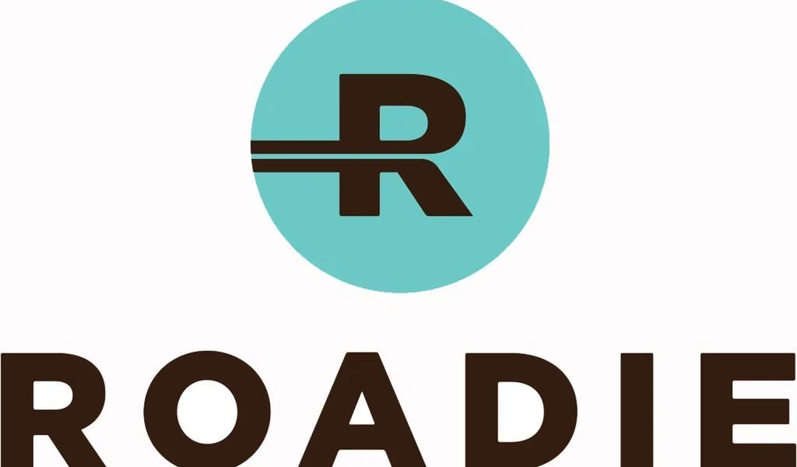
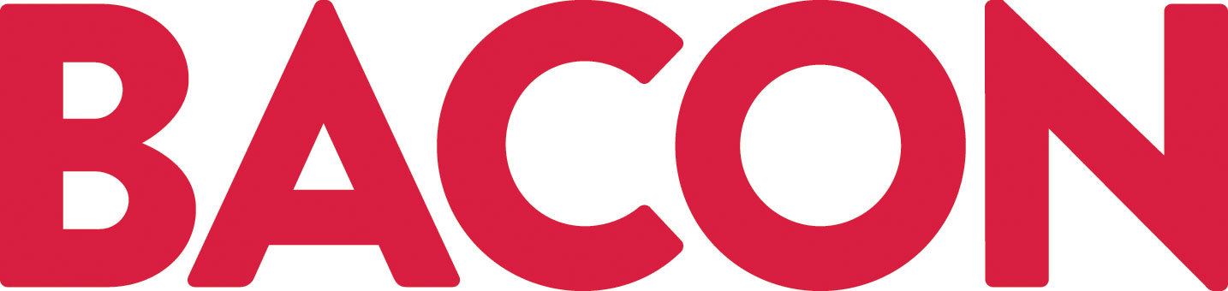


Our work has been informed by...
4
Black independent workers
1
Walk-a-mile
with member agency
11
interviews
70+
factors spanning Political, Economical, Social, Technological, Legal, Environmental landscapes
representing
these gig platforms:
Notes:
Kyle
Clarify PESTLE factors in one sentence.

Slide 8


Let’s meet two independent workers
Mateo & Annie
Video ONE
Notes:
Kyle

Slide 9


Slide 10
More about Mateo and Annie
Change in his industry
Relied on his existing knowledge
Lack of preparation
Laid off suddenly
Connected & planned
Been thinking and preparing
Notes:
That’s what their stories begin with. Mateo faced a long steady decline in opportunities in his industry, and Annie was suddenly laid off during Pandemic. Even though They both landed at gig work and small business from some unexpected changes. It was how they handled it that made the difference, Mateo relies mostly on his existing knowledge since he’s been doing it for 30 years and been great at it, he never really prepared for running his business through extensive study and practicing. But for Annie, She studied along the way of doing other jobs so she has more knowledge in starting her own business. She’s more connected and planned.
We’ll get back their stories after more exploration on independent workers here.
There are multiple ways people become independent workers. This is meaningful because most reports suggest that workers want to be doing this work and that’s not always true [KC]

Slide 11
Insights about Independent Workers
Notes:
After our research and interviews, we come to some insights about independent workers like Mateo and Annie.

Slide 12

They need more than a good idea.
They need a plan.
“First thing I would tell anyone trying to do their own thing is do not quit your job. Don’t quit your job until your business is substantial enough to pay your bills.
That was my biggest mistake.”
Was so excited to start, I didn’t look into what it cost to run my biz vs. what my biz was making.
“I was so excited to start, I didn’t look into what it costs to run my business vs. how much my business was making.”
Notes:
Many of the people we interviewed cannot emphasize more on decision making at the start of opening a small business. One regretted that he quit his job when first starting their business, because the business couldn’t stand of its own in the first couple of years and brings a lot of financial stress.
Just having passion and industry knowledge is not enough. They need more knowledge regarding starting a business and business finances.
Think about the ‘Why?’ for these. Whether we present them or speak to the why.

Slide 13
They seek financial education, tools, and ideas.
Research on US small business owners, conducted by Intuit Inc: [1]
81%
69%
66%
handle their business’ finances themselves.
have never taken a loan for their small business.
wish they knew more about their finances. [1]
[1] Intuit
Notes:
Here shows some data found by Intuit, there’s a big need from SBOs on their finance.
What we find out on how they manage finances is that Though each strategy was slightly different, all of the independent workers interviewed used some type of system, whether it was a more intuitive, visual, or physical “wallet” system, meticulously tracking numbers using advanced software, or hiring professional help.
There were a range of tax filing statuses (1099, LLC, sole proprietors), and those that separated business and personal finances adamantly recommended doing so.

Slide 14
...But sometimes distrust the institutions.
“Yes, I’m getting money for this business, but that business isn’t mine until this is paid off, and that always would stay in my head that I don’t actually own this.
I’m working for the bank, basically, until it’s paid off.. And the whole point of working for myself was to be like I do work for myself.”
“It’s just a personal thing – it’s a huge reason I didn't go to school – I just don’t think you should be tied to a bank so hugely to have to pay back. I just don’t think the reward for what you get is worth it.”
Notes:
We also found out that many were distrustful of institutions like banks and extremely averse to taking on any type of loans, as they feel that the business is not actually theirs until the debt is paid. They would say things like “I’m not working for the bank”, or “should be tied to a bank so hugely”.
Many are not aware that if they have good financial know-how, they can use debt and credit as a tool to build their business.

Slide 15



Successful independent workers are anything but independent.
They scaffold new experiences with previous experiences
They put their team together
They hire professionals
They network
Notes:
Successful independent workers are anything but independent. Most of the successful independent workers we spoke with sought out help. They research independently, seek advice from influencers, mentors, and friends, put together teams of people to compliment their strengths/ weak areas, and hire professionals when they can.

Slide 16

Notes:
Now let’s watch the rest of the stories for Mateo and Annie!

Slide 17
Insights on their journey
Tries very hard
Gut Feelings
Tries to do it alone
Tries very hard
Plan for the Unexpected
Seeks Mentorship
Notes:
In the video we see that they take on very different approaches and one was more successful than another. It may be due to their different personalities, but it could also be the different amount of resources available to them. Even though Annie pulled through the rough start successfully, it’s not easy as it looks like. Especially for the black and Latinx group, there are difficult situations to consider.

Slide 18
Focusing on Black & LatinX Independent Workers
Notes:
So even if both Annie & Mateo do everything right, they still only have a 4% chance of their business succeeding.

Slide 19
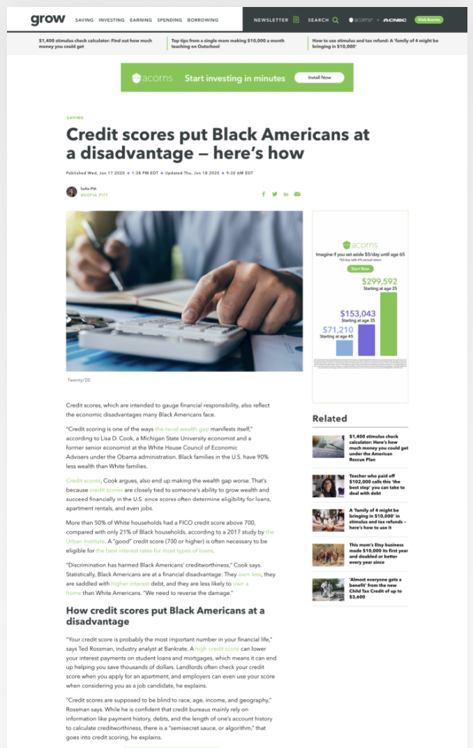
Credit and lending institutions don’t treat the Black and LatinX communities equally
More than 50% of White households had a FICO credit score above 700, compared with only 21% of Black households [1]
From 1933 to 1968, U.S. banks denied Black Americans access to financial services in a practice known as redlining. While this practice is illegal today, it had catastrophic, lasting results, Cook says: “It has forced many to turn to high-fee financial products like payday loans.” [1]
[1] Acorns
Notes:
Jess Credit and lending systems don’t treat Black & LatinX borrowers fairly. According to one study, More than half of White households had a credit score above 700, compared with only 21% of Black households. And this isn’t “just because it is”, it’s been contributed to greatly by historical lending practices steeped in inequality and systemic bias.

Slide 20
...so they are often forced to work around them.
45 M
“The white response to credit gone bad is to go searching for debt consolidation, etc. Where with Black people – it’s just ok, you got no credit. Can I pay you in cash? And live on spam & kool aid.”
- Geoff, Black business owner
45 million American consumers are so-called credit invisible, according to the Consumer Financial Protection Bureau. [1]
2 x
Black and Hispanic Consumers are almost twice as likely to have no credit score, with 15% rate of credit invisibility compared to 9% for White Americans. [1]
[1] Acorns
Notes:
Jess?
According to the Consumer Financial Protection Bureau, 45 Million American consumers are so-called “credit invisible”, with Black and Hispanic Consumers almost twice as likely to have no credit score. So they’re forced to find ways to work around the system.
In the words of Geoff, one of the Black business owners we talked to, “The white response to bad credit is to go searching for a debt consolidation plan. Where with Black people --- it’s just, Ok, you got no credit? Can I pay you in cash? And then I go live on spam & kool-aid.”

Slide 21
What does that mean for Black & LatinX small businesses?
-$72,000
4 %
Representation and participation in networking, mentorship, and sponsorship programs can help Black entrepreneurs overcome some sociocultural barriers.
- McKinsey
Black entrepreneurs start their businesses with about $35,000 of capital, white entrepreneurs $107,000. [1]
Only 4 percent of Black American businesses survive the start-up stage, even though 20 percent of Black Americans start businesses. [1]
[1] McKinsey
Notes:
Jess?
What does this mean for Black & LatinX small businesses? Black entrepreneurs start their businesses with on average $72,000 LESS than their White counterparts.
And since funding is a huge factor in whether a business will succeed or not, this puts minority business owners at a disadvantage from the start.
So, community support, mentorship, and planning are even more critical for them.

Slide 22
Opportunity
Notes:
We were asked to explore broadly around independent workers including gig workers, freelancers, and SBOs.
Within that space, and based on our most recent findings and analysis we’ve identified the most relevant area of opportunity to be support through the “rough start” phase for any independent worker breaking out on their own, particularly for Black and LatinX.

Slide 23



Representation
Community & Mentorship
3 Opportunity Gaps Identified
Personal, professional, financial
Connecting with success stories & role models
Upstream solution
NFCC’s point of intervention in the independent worker journey
Notes:
Jessica
Specifically this encompasses --
First, Community and Mentorship -- People seek support from those who are like them.. People who have been where they are personally, professionally, and financially.
2. Similarly, the power of seeing yourself in a success story cannot be underestimated. Seeing people like you succeed normalizes that success and makes it accessible.
3. Finally, a powerful leverage point lies in beginning the NFCC relationship with independent workers much sooner in their business and financial journey, rather than beginning with debt crisis.

Slide 24
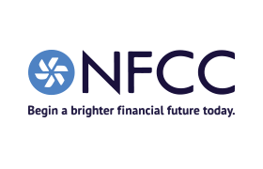
Upstream
Downstream
Maintain self-efficacy
through NFCC support
Mentorship
&
Community
MEMBER AGENCIES
Debt Management Plan
NFCC Awareness
Notes:
Jessica This creates an opportunity to “widen the funnel”, so to speak, and create relationships with independent workers on the foundation of NFCC as a “North Star” for overall financial wellness.

Slide 25



For Independent workers, we hope to move from a NFCC path that begins with a Debt Management plan....
….to a superhighway where a DMP is just a potential pit stop for financial wellness.
Financial Wellness
Coaching
Community
DMP?
DMP
NFCC
Credit health
Education
Notes:
Jessica What this means, is that for independent workers, there is an opportunity to move from an NFCC path that begins with a Debt Management Plan - where the customer is at rock bottom….
to a relationship where a DMP is simply a potential pit stop on the road to financial wellness

Slide 26
Requirements

Slide 27










Existing Experience
Proposed Experience
Focuses on the experiences of Black and LatinX independent workers
Broad focus on SBOs
Is reactionary
Is proactive
“Counseling”
Education and mentorship
Engages SBOs once they’ve identified NFCC member agencies as an option
Focuses on the debt management plan first
Meets independent workers before they call NFCC and perhaps before they’re even aware of who NFCC is
Understands debt is a symptom of a bad situation and not the cause
Notes:
Based on the research, we proposed something for the existing experience. Instead of focusing on the SBOs broadly, Black and LatinX independent workers should be the group that are in need of help. The existing experience is reactionary, we suggest that it should be more proactive and reach out to group actively. The next suggestion is to use education and mentorship to describe the service instead of counseling that makes people uncomfortable. The next is to meet independent workers before they call NFCC and perhaps before they’re even aware of who NFCC is, rather than only engaging small business owners when they are in debt issues.The final one, the debt is a symptom of a bad situation and not the cause so the focusing on the debt management plan first is not the only way to solve the problem.

Slide 28
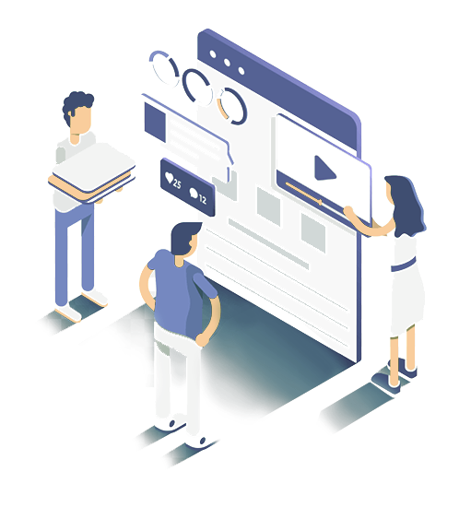
What’s NEXT
Co-design with SBOs to develop and iterate on community-driven solutions
Further user study with more interviews
Ideate and validate concepts and product functions.
Ideate concepts/ solutions
Validate product functions and proof of concepts through Further user study
Notes:
For the next step, we will codesign with SBOs to develop and iterate on community-driven solutions, and have further user study with more interviews, also ideate and validate concepts and product functions.

Slide 29
THANK YOU
Q & A

Slide 30
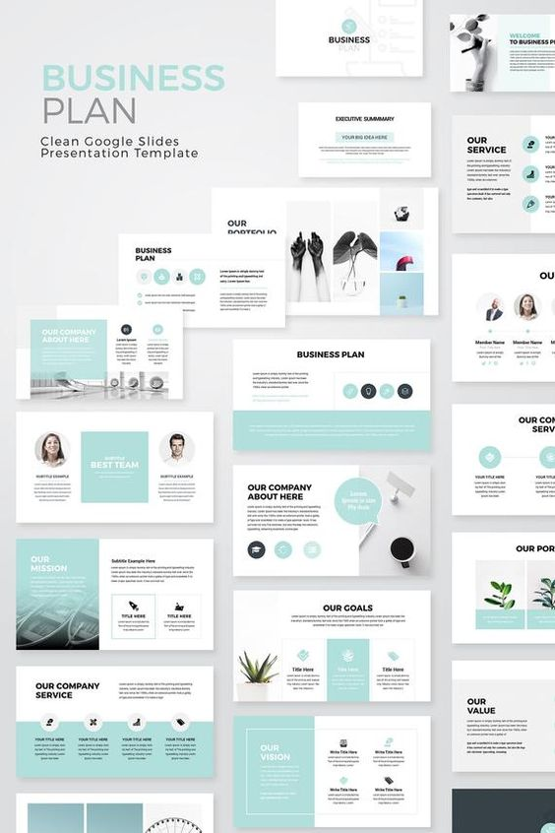
What did we KNOW🧑‍💻 about NFCC and the on-going program?
Notes:
NFCC works with partner agencies to offer credit counseling and debt management plans to people struggling with credit card debt.

Slide 31
Introduce problem space (scope & define)
Introduce the people we’re designing for (what we learned about them)
Video 1 (introduction)
What we did (who we talked to, how)
Insights into:
Independent workers
Black and latinX specifics
Walk-a-mile findings
Video 2 (checking back in)
Introduce the opportunity
Other:
What did we do (interviews, pestle factors, walk-a-mile, clustering)
The market (focus on millennials with untailored advice)
Notes:
NFCC works with partner agencies to offer credit counseling and debt management plans to people struggling with credit card debt.

